Slide 1
OEM Channel & Delivery
October 20th 2017
Kickoff document

Slide 2
Agenda for today
Topic
Duration
Presenter
Introduction and expectation setting
15 min
Morten
Introduction and expectation from ABB Digital/Ability
15 min
Rob M.
Present objectives and scope of accelerator
30min
Soenke, Karthik
OEM/distributor segmentation and workshop/interview approach
45 min
Adrian, McK
Coffee
15 min
Discuss value creation hypotheses/first use-cases
45 min
Jonas
Discuss engagement plan/interview partners
15 min
Karthik
First result/debrief from Liebherr workshop
15 min
Armin
Lunch
45 min
Share open topics and define immediate actions
30 min
All

Slide 3
Today‘s agenda
Introduction and expectation setting
1
Objectives, workplan and governance
2
OEM/distributor segmentation and workshop/interview concept
3
Value creation hypotheses
4
Engagement plan and Liebherr workshop debrief
5
Open questions and feedback
6

Slide 4

Accelerators have clear scope along technology stack and build on each other
Solution technology layers
Technology stack layer
Accelerator focus/Ability
ABB-provided solutions
Customer/partner-enabling solutions
Y
Remote service center
Collaborative Operations
Apps & Services
CALM
OEM & Channel delivery
Data aggregation
(incl. cloud storage)
Ability, Azure etc.
Cybersecurity
Connectivity (incl. gateways, standards/ protocols)
Wireless Connectivity
Devices & sensors
Connected Sensor Architecture

Slide 5
$120mUSD revenue and $60mUSD margin targeted by 2020
Objective of Digital Accelerator
Target outcome of Digital Accelerator
Enable and support the digitization of OEM/channel partners businesses (incl. Digital Powertrain in RM)
Build digital platform that enables OEMs/channel partners to grow spare and additional services/solutions sales
Provide data/insights to OEMs/channel partners as foundation for their new offerings
Increase revenue from new service models by ~20 mUSD by 2018 and by ~120 mUSD by 2020
Increase margin from new service models by ~9 mUSD by 2018 and by ~60 mUSD by 2020
Scaled roll-out to OEMs/channel partners across RM and IA in priority verticals (incl. commercial model)
1 End target of accelerator support; initiative subsequently handed over to line organization, funding from Digital ceases

Slide 6
Today‘s agenda
Introduction and expectation setting
1
Objectives, workplan and governance
2
OEM/distributor segmentation and workshop/interview concept
3
Value creation hypotheses
4
Engagement plan and Liebherr workshop debrief
5
Open questions and feedback
6

Slide 7
Overall project objective and high-level planning
Deliverables phase I (8 weeks)
Deliverables phase II
Definition and implementa-tion of product offering
Prioritized customer needs from interviewed OEMs/dist. partners
Offering tested and refined in workshops with OEMs (e.g., Solar Turbines, GEA) and distributors (e.g., Motion Industries, Sonepar) through concept workshops/mock-ups
Minimum viable product scope and feature roadmap defined
Functioning minimum viable product of platform deployed
Well-defined refined offering based on customer feedback from phase I
Development roadmap for full offering
Objective
Create a platform to enable OEMs / distributors to offer digital services to capture revenue on top of current sales
GTM strategy for roll-out
Prioritized sectors and segments
Business plan drafted
Scaling business plan
Roll-out plan
Fundamentals defined, e.g., pricing, sales incentives, product organization, sales motion

Slide 8
Focus of accelerator is on OEM/distributor offering
In Scope
Not in Scope
Platform to provide data, analytics and insights to OEMs and distributors of Drives and Motors (based on ABB Ability)
Integration of existing offering and analytics approaches
Sale of ABB SW and services through platform
Data generation and gathering from equipment (e.g., new sensors on equipment not in scope, instead use of existing data sources and analytics)
Continuous analysis of data by dedicated experts
Solutions tailored to specific customers and/or verticals
The successful outcome of the accelerator will be a commercial tool that can be sold to OEMs and distributors as a platform for digitalization

Slide 9
Potential setup: how we could jointly create value with OEMs and distributors for them and their customers
ABB provides digital services (raw data, insights), as well as product information, asset tracking and software services
OEM/distributor can integrate new services into current offering/enable additional service business
Customer receives service based on data/insights from ABB (customer interaction stays fully with OEM/disributor)
ABB
OEM/distri-butor
End
customer
OEM/distributor is able to reduce operating expenses (e.g., repair & maintenance, warranty cost)
OEM/distributor receives additional service revenue and increases pull-through and gains better understanding of customer’s use of equipment
This is just one potential setup - multiple solution and ownership combinations are likely across service delivery layers (data acquisition/ transfer/storage/analytics/visualization)

Slide 10
OEM/Channel delivery – overview of workstreams
Abbreviation
Meaning
KAM
Key account manager
TAM
Total addressable market
TSM
Total servable market
GTM
Go-to-market
Prep week
Nov. Week 1
Week 2
Week 3
Phase 1
Week 4
Week 5
Dec.
Week 6
Week 7
Week 8
Deliverables
20
23
24
25
26
27
30
31
01
02
03
06
07
08
09
10
13
14
15
16
17
20
21
22
23
24
27
28
29
30
01
04
05
06
07
08
11
12
13
14
15
18
19
20
21
22
OEM/
Distributor/
customer insights
Interactions with partners/ end customers scheduled, KAMs/ client contact briefed
Captured knowledge of ABB experts who conducted previous interviews
Workshops with ~10 selected OEMs/ distributors co-develop potential solutions based on “challenges/opportunities” in design thinking approach (incl. mock-up testing and value creation model) – some WS to be conducted by country teams based on pre-defined framework
Test MVP features
with selected pilot
customers
to further
refine solution offering
Interviews with 10-20 OEMs/Distributors to understand challenges/opportunities along value chain, potential digital solutions and requirements
ABB offering definition
Synthesize current offering and draft hypothesis on offering
Offering
hypothesis definition based on technical feasibility/ timeline
Gap between current offering and customer needs identified, showing development areas
Refined offering definition (incl. cost estimation) to be iterated with workshops partners
MVP features definition to design development roadmap of features to prepare for roll-out in next phases
…
Market/ Business plan
Market data and internal financial data collection
TAM and TSM definition and sizing
Target segment identification to set revenue aspirations for offering
Draft commercial model to be tested with customers, initial business plan
GTM model and value proposition definition (incl. CxO material) to reach out to pilot customers and plan roll-out in next phases.
……..
Key meetings
Project team Kick-Off
SteerCo I
SteerCo II

Slide 11
Governance and working team – phase I
Operational steering committee
Members
Role
Heikki V.
Morten W.
Robert I.
Javier R.
Rob M.
Meet twice during phase I
Approve recommendations and set direction
Address roadblocks
Working team
Working leadership
Role
Soenke K. (overall lead)
Twice weekly check-ins
Set operational direction
Make recommendations to steering committee
Bernd H.
Karthik I. (100%)
McK project manager (100%)
Area
ABB team
Commitment
Role
OEM/ Distr./ customer insights & offering definition
Adrian G. + team (TBC) - DR
70-80%
Participate in interviews and co-develop offerings
Co-develop product definition, plan product development for the MVP phase
Jonas Spoorendonk - MG
70-80%
2 McKinsey consultants supporting across all workstreams, pot. including a UX designer for mockup design
Market/ Business plan
Digital bus. dev. mgr. – DR - TBC
100%
Support market sizing and assessment
Co-develop comm. model, value prop & CxO materials
Digital bus. dev. mgr. – MG - TBC
100%
Extended team
Subject matter experts - identified
As needed
Vertical/Solution SMEs as needed
Digital platform expert
As needed
Support client WS on platform capabilities
Ability platform prod. manager - Sean P./Simo S.
As needed
Ensure alignment with Ability solution
Controller, DR - TBC
As needed
Provide business data and validate revenue ambition/business plan
Controller, MG - TBC
As needed
Co-location of fully dedicated team members in Heidelberg (Ladenburg from 1st December) will be critical

Slide 12
Today‘s agenda
Introduction and expectation setting
1
Objectives, workplan and governance
2
OEM/distributor segmentation and workshop/interview concept
3
Value creation hypotheses
4
Engagement plan and Liebherr workshop debrief
5
Open questions and feedback
6

Slide 13



The attractiveness for ABB of digitally enabled services depends on the depth of value creation and the scalability of the solution
Scalability of service offering
Global OEMs
Technical distributors
Limited digital capabilities and strong service focus
Interested in new digitally enabled services and will need support – many small players which can best be served with standardized, easy-to-deploy solutions
High
Strong digital capabilities
Interested in (raw) data access and basic analyses/algorithms to include in existing offering
Logistical distributors
Small/medium OEMs¹
\
Limited services offering
Likely standard solutions , pot. incl. E2E services
Digital capabilities and appetite unclear and to be further assessed
Limited digital capabilities
Solutions should be focused on a couple of common themes or where current ABB offerings can be heavily leveraged
Low
Low
ABB value creation opportunity
(excl. margin split)
High
The revenue impact potential and margin split for ABB and the OEMs/distributors have to be assessed in a next step (e.g., based on current business with ABB, share of wallet, potential upselling)
1 Includes system integrators

Slide 14








These four customer segments have distinct profiles with regards to their service ability and digital capabilities
Service focus of OEM/distributor
Digital capability of partner
Needs and requirements
Examples
Global OEMs
Often provide complete range of services (incl. digital) to end customers
Generally digitally sophisticated
Often offering proprietary dig. solutions to end customers
Often offer own solutions, (e.g., condition monitoring) but need interface ABB raw data; cannibalization of current offering needs to be understood
Small/medium OEMs
Generally high service focus (challenging to fulfill due to small size and differentiated products)
Sometimes subcontract service providers to deliver end customer service
Low digital capabilities and limited resources (mainly small companies) to develop own solutions or conduct sophisticated analysis
Seeking for new full service solutions (e.g., advanced analytics insights) in order to complement their service offering
Likely require support from ABB (technical, leverage ABB install base)
Technical distributors
Service focus within traditional services (e.g., repairs) mainly for single-axis products and local customer base
Very limited digital capabilities (due small size of organization)
Likely to be interested in extending their service portfolio (ranging from fleet mgmt. integrated into administrative processes to advanced insights)
Likely require support from ABB (technical and analytical capabilities)
Logistical distributor/ wholesaler
Mainly “box moving”, very limited service offering
To be confirmed if interested in light-operations service offerings
Today focus on e-commerce solutions only
Limited capabilities to serve end customer with sophisticated service solutions
Need for product data (e.g., 3D diag.)
Interest of logistical distributors/ wholesalers is unclear, potential interest in e2e solutions (concerns about directly approaching end customers to be assessed)

Slide 15
Approach for workshops and interviews with OEMs and distributors
Interaction type
Target group
Description/objective
Target number/modus operandi
OEMs/ distributors interviews
OEMs/ distributors with potential interest, but no/limited current discussions on topic
Cover wide range of sizes/geographies/ verticals to capture full breadth of requirements
Understand current digital sophistication, ambition and strategy
Discuss and understand “challenges and opportunities” along value chain
Assess interest in potentially co-developing solutions and workshops
1.5-2 hours,
Of which: ~8-10 in person
10-20
OEMs/ distributors workshops
OEMs/ distributors already engaged in advanced discussion on digital solutions
Explicit requests for collaboration and workshops
Collect challenges and opportunities to create draft proposal for solution, including monetization model toward end customer
Should be conducted without pre-defined offering, but using hypotheses and design thinking approach based on OEMs/distributors challenges and opportunities
In person 0.5-1 day workshops (depending on customer, most likely integrated in overall visit)
~10
For both types of interactions, modular framework to conduct sessions will be developed so it is replicable by country digital leads (both during project and thereafter)
After initial set of interviews and workshops have been conducted, MVP/use-case scope to be defined and “pitch material” to be shared with local digital leads/sales managers to test with further customers

Slide 16
Proposed setup and agenda topics for interview
Interview setup
Proposed high-level agenda
Logistics
In person on customer premises or via skype/conference call
1.5-2 h discussion (1-1.5 if via phone)
Topic
Goal and scope of interview
Conduct open discussion on potential for future collaboration – not “sales call” on current products/offering
ABB participation
1-3 members of our project team with expertise in developing digital solutions
Customer’s key account manager/sales contact ideally not present to ensure open conversation
Digital status quo and aspirations
Understand customer’s current digital capabilities/aspirations and discuss current demands from end-customers
Challenges, opportunities and aspirations
Discuss high-level value chain (as shared in this document), identify current challenges and opportunities along it and assess strengths and weaknesses and potential digital solutions
Proposed participation from OEM/distri-butor side
ABB contact person in customer’s company
(Digital) portfolio manager
Experts along value chain (e.g., service manager, operations mrg., business dev./sales manager)
Concerns, requirements and next steps
Discuss implementation requirements (e.g., data stored locally) and potential concerns (e.g., data safety)
Depending on interest/concreteness, offer follow-up and concrete co-creation in workshop
Conduct interview based on questionnaire with minimal power point pages
Questions to be phrases/posed in open way, to ensure unbiased responses
If customers agree, interviews to be recorded/transcribed to be able to separate quantitative statements from opinions

Slide 17
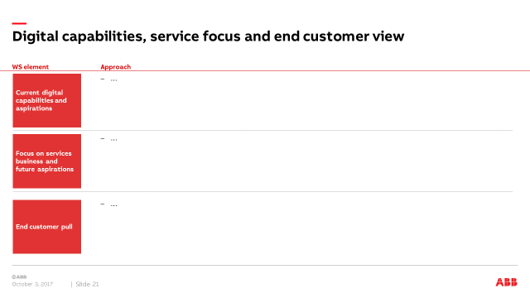
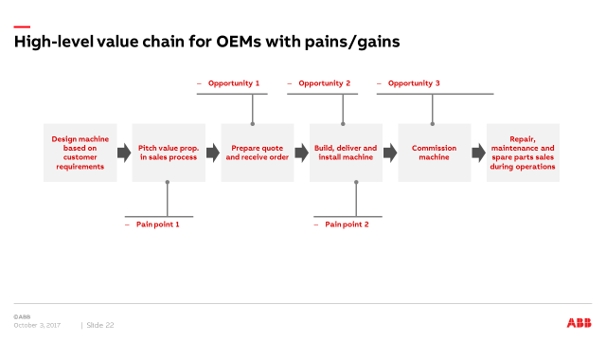
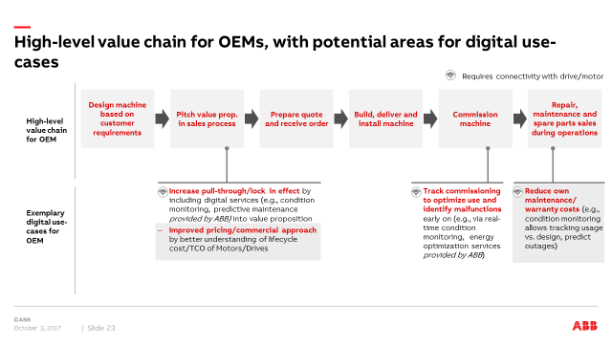
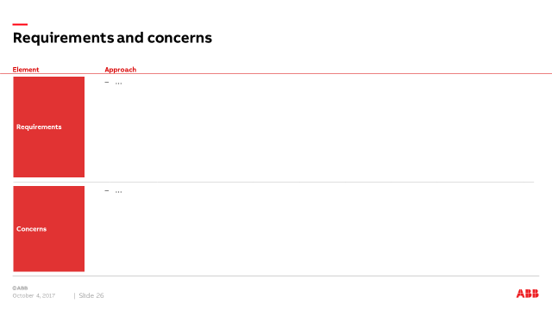
Target outcomes from interviews
Understanding of current digital strategy, service focus and end-customer pull
View on value chain and current challenges/opportunities
Strengths/weaknesses and main digital opportunities along value chain
Requirements and concerns on digital offering

Slide 18
Proposed setup and agenda topics for workshop
Interview setup
Proposed high-level agenda
Logistics
In person on customer premises
Half-day or full-day workshop depending on previous discussions
Topic
Goal and scope of interview
Conduct open discussion on potential for future collaboration – not “sales call” on current products/offering
ABB participation
1-3 members of our project team with expertise in developing digital solutions
Customer’s key account manager/sales contact ideally not present to ensure open conversation
A digital/platform expert for technical questions
Digital status quo and aspirations
Understand customer’s current digital capabilities/aspirations and discuss current end-customer demands
Challenges, opportunities and aspirations
Discuss high-level value chain (as shared in this document), identify current challenges and opportunities along it and assess strengths and weaknesses and potential digital solutions
Proposed participation from OEM/distri-butor side
ABB contact person in customer’s company
(Digital) portfolio manager
Digital lead/platform expert (if in place)
Experts along value chain (e.g., service manager, operations mrg., business dev./sales manager)
Value proposition development
Select most central potential solutions from above and co-develop specific use-cases that could address them (incl. design of mock-up)
Requirements and concerns identification
Select most central potential solutions and discuss requirements and concerns, monetization model for you and potential contribution by ABB (e.g., digital capabilities, data/know-how on products)
WS approach should be modular, to be adapted based on OEM/distributor situation and scope of previous discussions

Slide 19
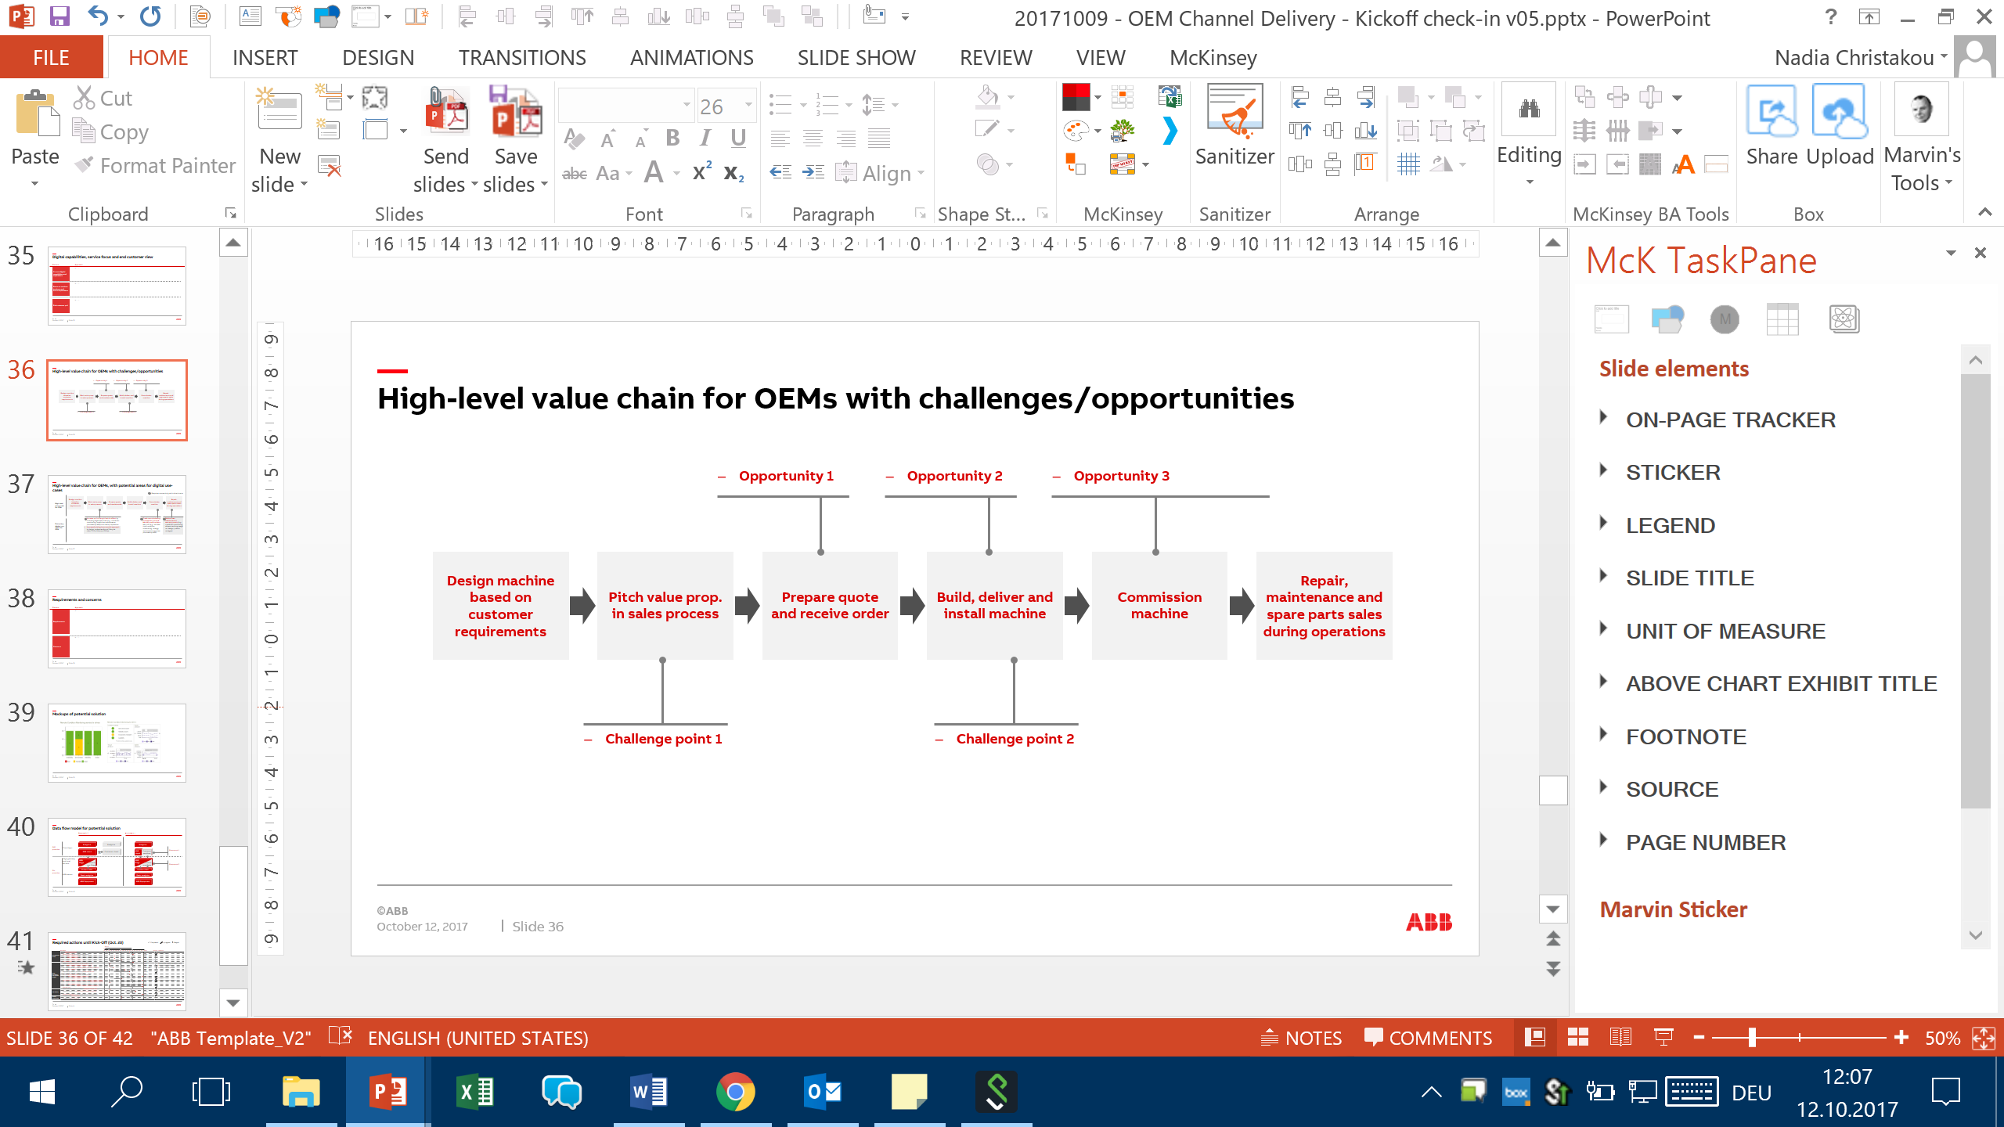
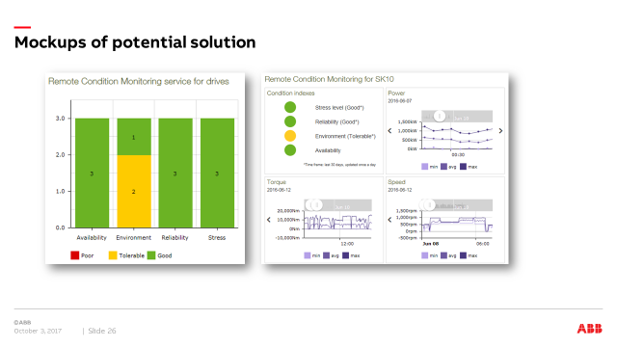
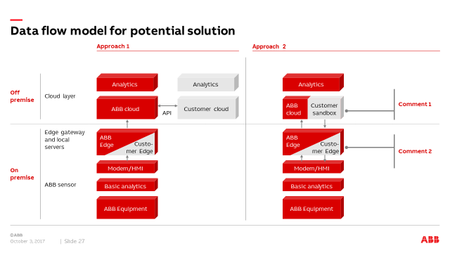
Workshop targets concrete co-design of the most prominent solutions
View on value chain and current challenges/opportunities
Strengths/weaknesses and main digital opportunities along value chain
Mockups of potential solution, co-developed in WS with help of designers
Data flow and required interfaces
Requirements and concerns on developing such solutions

Slide 20
We will use high-level value chain for OEMs and distributors to discuss potential digital solutions
OEMs
Design machine based on customer require-ments
Pitch value prop. in sales process
Prepare quote and receive order
Build, deliver and install machine
Commission machine
Monitor in warranty period
Repair, maintenance and spare parts sales during operations
Conduct retrofit or obso-lescence
Technical distributors
Acquire service contracts based on geographical footprint, vertical/application expertise, existing relationships
Repair, maintenance during operations (incl. upgrades, e.g., condition monitoring, energy consumption)
Spare part/replacement sales as part of operations (various suppliers¹)
Wholesalers
Create product portfolio to fit demand
Provide (online) catalogue to end customers
Receive and deliver order (focus availability and on-time)
Limited/on-demand only: repair, maintenance and spare parts sales during operations
As a preparation, OEMs/distributors should think about:
Are there additional central elements in the value chain?
What are challenges and opportunities along these elements?
1 Esp. for RMMG, very limited captive parts/spares

Slide 21




Plan to test outcomes from interviews/workshops with selected end customers
Approach
Potential end customers
Test outcomes from interviews/workshops with selected end-customers, to understand interest in offering of OEMs/distributors and potential concerns (e.g., access to data)
Potentially, approach them as McKinsey, not ABB, to avoid appearance of conflict with OEMs/distributors
End customers should come from range of industries and digital capabilities
Tend to be aggressive on adopting new technology
Preliminary discussions with them show concerns about sharing data relevant for processes
IAOG and RMMG project ongoing on smart sensors of pumps/motors (N.B.: potentially to be replaced by discrete manufacturer)
Already projects ongoing on energy efficiency, limited digital capabilities at present
Preliminary customer list – to be finalized based on outcomes of interviews

Slide 22
Today‘s agenda
Introduction and expectation setting
1
Objectives, workplan and governance
2
OEM/distributor segmentation and workshop/interview concept
3
Value creation hypotheses
4
Engagement plan and Liebherr workshop debrief
5
Open questions and feedback
6

Slide 23
OEM/Distributor use-cases are built on a set of applications, which need to be enabled by platforms, connectivity and others
Description
Examples
OEM/distributor use-cases
Use-cases directly enable value for the OEM/Distributor, either by leading to increased revenues for end customers, or enabling cost reductions
Reduce warranty costs (e.g., tracking of machine usage vs. design; prediction of outages)
Expedite commissioning process through virtualization (pot. incl. SW maintenance contract, ABB SW suite )
Underlying applications
One or several “building blocks”/features enable the realization of use-cases
Applications can be built/provided by ABB or developed by OEMs
Real time condition monitoring of drives/motors
Fleet information dashboard
Enablers for implementation
A number of enablers need the be in place to ensure the implementation of applications and use-cases
Some enablers can already be in place at some OEMs/distributors, some should be provided by ABB
Delivery platform (incl. cloud-to-cloud interfaces)
Analytics algorithms
Connectivity (gateway, protocols)
SW retail capabilities

Slide 24
Potential interview outcome: identified potential digital use-cases along OEM value chain
Design machine based on customer require-ments
Pitch value prop. in sales process
Prepare quote and receive order
Build, deliver and install machine
Commission machine
Monitor in warranty period
Repair, maintenance and spare parts sales during operations
Conduct retrofit or obso-lescence
Virtualization/ digital twin for development/ simulation using ABB SW suite (incl. standard library of components)
Improve quote quality/performance by full/improved access to documentation/pricing info to generate competitive quote (e.g., 3D diagrams, warranty info, spare parts list; via ABB portal, pot. using QR-code on motor)
Speed up commissioning and identify malfunctions and root causes (e.g., via real-time condition monitoring; could include monitoring of tuning parameters). Pot. also available via unconnected “flight recorder”
Reduce maintenance costs/times through access to failure and R&M history, lifecycle data etc. (e.g., pot. also available via unconnected “flight recorder”; depends on current commercial model – time and material vs. uptime/outcome based)
Hypotheses to be developed ahead of interaction together with KAMs – only to be used as “cheat sheet” in customer interactions

Slide 25
Use-case landscape and requirements (1/2)
No necessary/possible
Possible/Helpful but not required
Required/possible
Current hypothesis on most promising use-case
Connectivity to devices required
Retrofit on installed base possible
Relevance/value to customer segment
OEM/Distributor use-case
Enabling features by ABB
Value creation OEM/Distributor
Value creation ABB
Global OEMs
Sm/Med OEMs
Whole-salers
Technical distr.
Design support
Optimization of offering by using insights into current machine usage (e.g., via remote monitoring of drive); e.g., avoid over dimensioning
N/A
Condition monitoring
ABB analytics based on domain expertise
Increased HW sales
Lock-in effect (larger HW sales)
Not necessarily real time; anonymized
Virtualization/ digital twin for development/ simulation using ABB SW suite (incl. standard library of components)
Digital twin
Simulation offering
Faster time to market, better tailoring
Service revenue/pull through
Lock-in effect for OEM (larger HW sales)
Services revenue (digital twin)
Simplification of data acquisition for end customer by using motor/drive monitoring to partially replace current SCADA systems
Condition monitoring/sensors
Increased HW sales (through better value prop)
Lock-in effect (larger HW sales)
Services revenue (cond. monitoring/sensors)
Enable additional services
Increase services revenues, either by reselling ABB digital services (e.g., condition monitoring, predictive maintenance) or creating new integrated services partly based on ABB services (e.g., live torque monitoring for end customer, remote access for safety/ accessibility improvement, energy optimization services)
Condition monitoring, smart sensor, predictive maintenance, Apps
Lock-in effect
Increased service rev. and HW sales
Lock-in effect for OEM/dist (larger HW sales)
Services revenue from digital offering
Go to market support
Increase HW sales by sales lead generation based on fleet tracking/ condition monitoring insights (e.g., warranty expiry, average product lifecycle, live outages – ABB portal/data; incl. virtual replacement of devices at end of life)
Digital twin
Condition monitoring
Increased return customers/services sales
Platform service revenue
Lock-in effect for OEM/dist (larger HW sales)
Improve quote quality/performance by full/improved access to documentation/pricing info to generate competitive quote (e.g., 3D diagrams, warranty info, spare parts list; via ABB portal, pot. using QR-code on motor)
N/A
Digital twin/product data
Increased HW sales
Lock-in effect for OEM/dist (larger HW sales)

Slide 26
Use-case landscape and requirements (2/2)
No necessary/possible
Possible/Helpful but not required
Required/possible
Current hypothesis on most promising use-case
Connectivity to devices required
Retrofit on installed base possible
Relevance/value to customer segment
OEM/Distributor use-case
Enabling features by ABB
Value creation OEM/Distributor
Value creation ABB
Global OEMs
Sm/Med OEMs
Whole-salers
Technical distr.
Go to market support
Reduce working capital by improved demand forecasting based on historical lifetime data (and pot. live tracking)
Digital twin
Condition monitoring
Lower net working capital (esp. spares)
Lock-in effect (larger HW sales)
Margin increase through Improved pricing/commercial/service strategy based on better understanding of lifecycle cost/TCO of Motors/Drives (i.e., quantification of risks)
N/A
Fleet insights (e.g., average lifecycle)
Increased HW sales
Increased services revenue
Monetization of fleet inisghts
Lock-in effect for OEM/dist (larger HW sales)
Commiss-ioning support
Speed up commissioning and identify malfunctions and root causes (e.g., via real-time condition monitoring; could include monitoring of tuning parameters). Pot. also available via unconnected “flight recorder”
N/A
Condition monitoring, smart sensor, Apps
Speeding up of time to full accepted commissioning
R&M cost reduction
Lock-in effect for OEM/dist (larger HW sales)
Expedite process through virtual commissioning via ABB simulation suite (pot. incl. SW maintenance contract)
N/A
Simulation offering
Digital twin
Warranty and repair/ maintenance cost reduction
Reduce warranty costs (e.g., condition monitoring allows tracking usage vs. design; prediction of outages). Pot. also available via unconnected “flight recorder”
Condition monitoring (connected or as “flight recorder)”
Reduce maintenance costs/times through access to failure and R&M history, lifecycle data etc. (e.g., pot. also available via unconnected “flight recorder”; depends on commercial model – time and material vs. uptime/outcome based)
Digital twin
Fleet insights/ historical data
R&M cost reduction
Risk management
Digital services revenue from fleet insights (shared with OEM/Dist)
Lock-in effect for OEM/dist (larger HW sales)
Reduce maintenance costs/times through root cause identification via 3D simulation/ digital twin
Digital twin
Fleet insights/ historical data
Provide more complex services (or by lower-qualified staff) using ABB tools/insights (e.g., predictive maint.)
Fleet insights/ historical data
Increased service rev.
R&M cost reduction
Digital services revenue from fleet insights (shared with OEM/Dist)

Slide 27
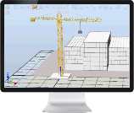


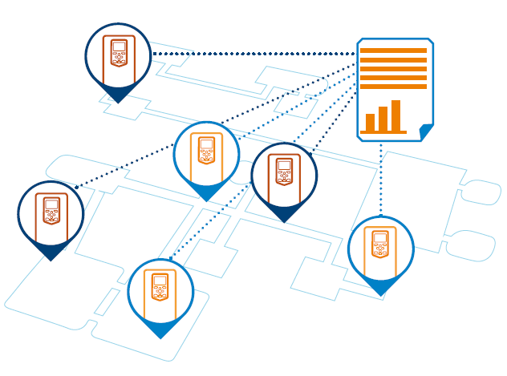
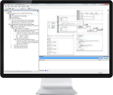
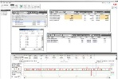

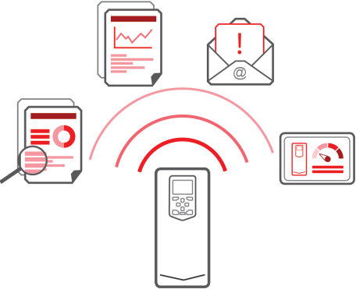
Use-cases are enabled by six types of applications/“building blocks”, with current ABB offering in all of them
Meta product data from ABB
Historic data on OEM/distributor fleet
Live data/connectivity
Advanced analytics tools
Virtualization
Virtualization applications (e.g., virtual commissioning, drive tuning, virtual automation engineering)
Fleet insights based on historic data
System performance evaluation/ analysis
Energy optimization and consumption analysis
Lifecycle stage and cost assessment for maintenance prioritization/long-term replacement savings
Real time analytics
Intelligent monitoring/ diagnostics system and real time data cockpit
Predictive maintenance kit
Basic software/tools
Product information
Online portal to centrally access information on ABB products, (incl. Digital twin). e.g.:
Spare parts list
Access to 3D models
Warranty information
Fleet data portal
Online portal to provide information on installed equipment, incl. personalized dashboard, e.g.,:
Product location
Warranty/ life cycle status
Real time monitoring
Remote /on-site condition monitoring

Slide 28
Potential MVPs will enable offering of applications and use-cases to OEMs/distributors
ABB algorithms on customer cloud
Remote analytics services delivered via Ability
ABB cloud including hosting of customer extension (pot. white-labelled)
Static data access
Raw machine data access
ABB cloud (pot. white-labelled)
Global OEMs
A
Intercloud connection for access to data, raw or pre-processed.
Goal: deliver analytics services to OEMs/end customer (e.g., preventive maintenance, outlier analysis) via (white-labelled) Ability platform
Delivery: insights from Ability to OEM/Distributor/end customer via (white labelled) HMI
Sensor connectivity: collect data from ABB devices on customer premises (either customer or ABB gateways)
Cloud: running entirely on Ability
Analytics/algorithms: ABB proprietary analytics run on Ability cloud
ABB monetization: yearly PaaS fee and increased share of wallet
Small/medium OEMs
Goal: enable OEMs to build own predictive maintenance offering (either for sale to end customer, or internal cost reduction/process improvements)
Delivery: OEM delivers services to end customers/uses for own purposes
Sensor connectivity: automated, single common infrastructure
Cloud: final destination customer cloud, access to (pre-processed) raw data from sensors (pot. required cloud-to-cloud API)
Analytics/algorithms: developed by OEM, pot. support from ABB, delivered via (licensed) SW
ABB monetization: via yearly license fee and increased share of wallet
B
Ability platform based analytics services
Technical distributors
Goal: provide central and customized access to fleet management data (e.g., location tracking) product data (e.g., spare parts list, warranty information, 3D diagrams)
Delivery: delivered to distributor cloud via cloud-to-cloud API or directly from Ability via HMI
Sensor connectivity: no operational data required, (pot. scanning QR-code on device)
Cloud: data collected on Ability cloud (pot. incl. fleet data from distributor)
Analytics/algorithms: N/A
ABB monetization: increased share of wallet, increased attractiveness of value provider contract, ease of doing business
Logistical distributor/ wholesaler
C
Cloud-based centralized access to fleet and nominal product data
Hypotheses of potential platform solutions – learning from interviews will be used to refine this (incl. revenue aspiration, implementation timeline, etc.)

Slide 29
Use-cases can be realized with different data flow models based on OEM/Dist preferences, directly affecting possible monetization options
Static data access
Raw data access
Advanced insights
Remote analytics services delivered via Ability
ABB cloud including hosting of customer extension (pot. white-labelled)
Static data access
Raw machine data access
ABB algorithms on customer cloud
ABB cloud (pot. white-labelled)
Data flow¹
“Static product data provided by ABB”
“Data processed and analyzed by customer with proprietary algorithms”
“Data processed and analyzed by customer using ABB software¹”
“Data captured and analyzed by ABB, insights provided to customer cloud”
“Fully ABB-enabled analytics with customer branding”
“Customer cloud integrated with ABB cloud in ‘sandbox’ – includes ABB and other equipment analytics”
HMI
HMI
HMI
HMI
Cust. HMI
Cust. HMI
Analytics
Analytics
Analytics
Analytics
Analytics
ABB HMI
ABB HMI
Off premise
Analytics
Analytics
Analytics
Analytics
ABB cloud
(incl. static
Data)
Customer cloud
Customer cloud
ABB cloud
(incl. static
Data)
ABB plug-in
Customer cloud
ABB cloud
(incl. static
Data)
Customer
cloud
ABB cloud
(incl. static
data)
ABB cloud
(incl.
static
data)
Custo-
mer sandbox
API
ABB API
API
Customer Edge
ABB plug-in
Customer Edge
ABB Edge
ABB Edge
ABB Edge
Custo-
mer Edge
Custo-
mer Edge
Custo-
mer Edge
On premise
Modem/HMI
Modem/HMI
Modem/HMI
Modem/HMI
Modem/HMI
Basic analytics
Basic analytics
Basic analytics
Basic analytics
Basic analytics
ABB Equipment
ABB Equipment
ABB Equipment
ABB Equipment
ABB Equipment
Potential monetization approach
Recurring subscription/license for data access or API
Built in to price of device
Recurring subscription/license for data access or API
SaaS, monetized via license, recurring subscription or updates
Pay for given outcome/insight
Subscription fee
Pay for given outcome
Subscription to use ABB cloud (PaaS)
Pay for given outcome
Subscription to use ABB cloud (PaaS)
ABB collects data to refine own algorithms
Many end customers are building own digital platforms and are looking for OEMs to provide data/interface into it
1 Further data flow models also possible, depending on OEM/Distributor demands and requirements – to be assessed in interviews

Slide 30












There are three distinct types of competitors in industrial IoT applications for OEMs and distributors
Description
Main value contribution
Example players
Industrial supplier
Extensive experience and domain expertise in industrial grade HW
Long-term relationship with customers
Only now entering digital space
Deep understanding of components and behavior that could be leveraged for the development of applications
ABB and other machine builders with competitive advantage relative to other competitors for OEMs/ distributors:
Long-term relationship
Integration with HW
Possibility to cross-subsidize digital
Sensing giants
Often from niche/specialist applications
Targeting high value segments and digitally savvy
Offer sophisticated and highly priced sensing equipment
Deep experience in sensing applications
Deep understanding of specialized critical applications
Tech-entrants
Limited experience with industrial-grade HW/SW
Offer lower quality and low-priced products
Often come from different applications/ industries
IoT and SW/Cloud experience
Enhanced customer experience (e.g., easy purchase, shipping)
Additionally, end customers (e.g., BASF) are building their own cloud systems, potentially taking large parts of value creation¹
1 However, highly unlikely that end customers will develop their own hardware

Slide 31
Today‘s agenda
Introduction and expectation setting
1
Objectives, workplan and governance
2
OEM/distributor segmentation and workshop/interview concept
3
Value creation hypotheses
4
Engagement plan and Liebherr workshop debrief
5
Open questions and feedback
6

Slide 32



































Overview of current OEM/ Distributors interview/WS status
KAMs fully briefed/preliminary customer discussion
KAMs engaged
Customer in scheduling discussions
WS/int. scheduled/completed
Global OEM
fans and blowers
pumps and compressors
pumps
separators
compressors
cranes
cranes
pumps
turbo machinery
diesel engines, marine equipm.
compressors and mining equipment
extruders and compressors
pumps
Marine equipm.
pumps
Small/ medium OEM
pumps
extruders
fans and blowers
pumps
fans and blowers
sugar machinery
compressors
Whole-saler
Beijing Ouneng
Nanjing Smart
Technical Distributor
Additionally, plan on engaging selected IA customers (e.g., Marine & Port) to ensure solution can also cover those requirements

Slide 33
Outcomes from interactions with OEMs/distributors
High
Low
Overall assessment of potential for MVP
Digital maturity
Digital ambition
Current ABB relationship
Source/ Interaction
Main concerns/ requirements
Customer
Type
Key applications
Architecture/impl.
Next steps
Supplier for cranes (mainly internal)
Global OEM
Established motors & PLC customer
New drives customer
Workshop 17.10
Basic drives and motors condition monitoring (incl. smart sensors, sold to end customers)
Analytics algorithms for drives, to be used on Liebherr drives
Would like to use own cloud (testing Microsoft Azure)
Limited cloud arch. expertise; open to fully using Ability/ABB know-how
Establishing of connectivity with end device (e.g., via ABB SPS, use existing PLC/Modem setup)
Maintain Liebherr brand
Follow-up meeting on connectivity, implementation of cond. Monitoring
Pilot before cust. roll-out

Slide 34
Konzept
 | ++ | + | - | --
Potential
Machbarkeit
Priorität
Titel: Zustandsanalyse Antriebsstrang – Cloud / edge architecture
Applikation / Bedarf / Problem / Anforderung
Cloud architecture for condition Monitoring for motors, drives, capacitors
Update of Software (FW, PLC application, data analysis algorithm)
Accessing live data (already pre-analyzed, ABB‘s know-how) but more then a traffic light
Liebherr brand needs to be labelled
Flexible solution required similar to ABB‘s channel challenge
Lösungsidee
Cloud: Liebherr does first steps with MS Azure (using MS's competency in data analytics, no Liebherr data scientists)
Most promising scenarios (see next slide)
"ABB algorithms on customer cloud" (MS as Liebherr's cloud provider)
"Remote analytics services delivered via Ability" (MS as Liebherr's cloud provider)
"ABB-hosted customer cloud" (ABB as Liebherr's cloud provider)
Edge: Extension of existing solution LiTU / LiDAT
Routing through PLC (ProfiNET), local or global → use PLC instead of NETA-21
For test cranes: NETA-21
Potentieller Nutzen
Solution that fits for different channel scenarios (OEM, end-user, …)
Business model:
Main challenge at the moment to get data from the field, then analysis required what benefit for customers / Liebherr could be for prediction of condition of components
Business model depending on their OEM customers (mainly internal Liebherr units, but also external companies)
Barrieren
Connectivity from field to cloud (edge, infrastructure, data access)
Security, IP
Data / info flow
Mehrstufiger Vertriebsprozess
Data access - who can see what?
Together
Do better
Do more
Know more
 | Plan & Prod | Eng & IBN | Betr & Mon | IH & Upgr

Slide 35
Today‘s agenda
Introduction and expectation setting
1
Objectives, workplan and governance
2
OEM/distributor segmentation and workshop/interview concept
3
Value creation hypotheses
4
Engagement plan and Liebherr workshop debrief
5
Open questions and feedback
6

Slide 36
Open questions and feedback
Are there any additional workshop/interview partners that should be considered?
How will we ensure adequate resources for development of Minimum Viable Product (phase II)?
How can we ensure we keep IP from meeting outcomes, esp. if OEMs/Distributors insist on NDA
Any other open questions and feedback?

Slide 37
BACKUP

Slide 38
Modus Operandi – An agile work approach
Working principle
Supporting mechanism
“Our work is driven by the needs of OEMs, distributors and end customers”
We put end-customers and OEM/distributor need at center of solution, iterating quickly in a solution-focused and action-oriented way
Fast and effective onboarding of new team members via briefing calls and kick-off meeting
Enable by flexible work approach with strong execution focus and rapid development
Co-location of core team in Heidelberg
Weekly operational stand-ups (Monday mornings) to align on team and workstream priorities for the week (incl. reprioritization of topics and staffing)
Alignment meetings (every two days) with complete team to problem solve content topics
Fast escalation to SteerCo/ leadership possible to flag on potential road blockers and decide on resolutions, implemented via weekly update calls with Javier and Rob to ensure alignment
“Our work approach is fast and agile, using design thinking”
“Our team is committed and has a strong execution focus to ensure rapid solution development”
“Project process ensures continuous alignment across all stakeholders (CDO, MG, DR)”

Slide 39
Key working team members – roles and responsibilities
Workstream
ABB team
Commitment
Role
Responsibility
OEM/ Distr./ customer insights & ABB offering definition
Digital portfolio mgr (x2: DR, MG)
70-80%
Participate in interviews, synthesize insights and co-develop offerings
Help prepare and conduct customer workshops and take leading role in workshops
Co-develop product definition, plan product development for the MVP phase
Going forward: own the product during the MVP phase and further develop solutions developed in this effort
Ensure hypotheses fit current portfolio/plan
Ensure smooth and effective workshops and coordinate outcomes
Market/ Business plan
Business development manager (x2: DR, MG)
100%
Participate in customer interviews, help to segment and size market
Co-develop commercial model and value prop
Prepare and participate in workshops, esp. on commercial model
Support GTM strategy definition and development of CxO materials
Ensure consistency of offering to current strategy and adjust if required
Ensure strong communication of value proposition (internal and external)
Ensure alignment with overall sales strategy and sales teams
Sales reps support to establish contact and alignment with local sales teams
Subject matter experts and controlling resources to be engaged on specific topics on an as-needed basis

